Slide 1
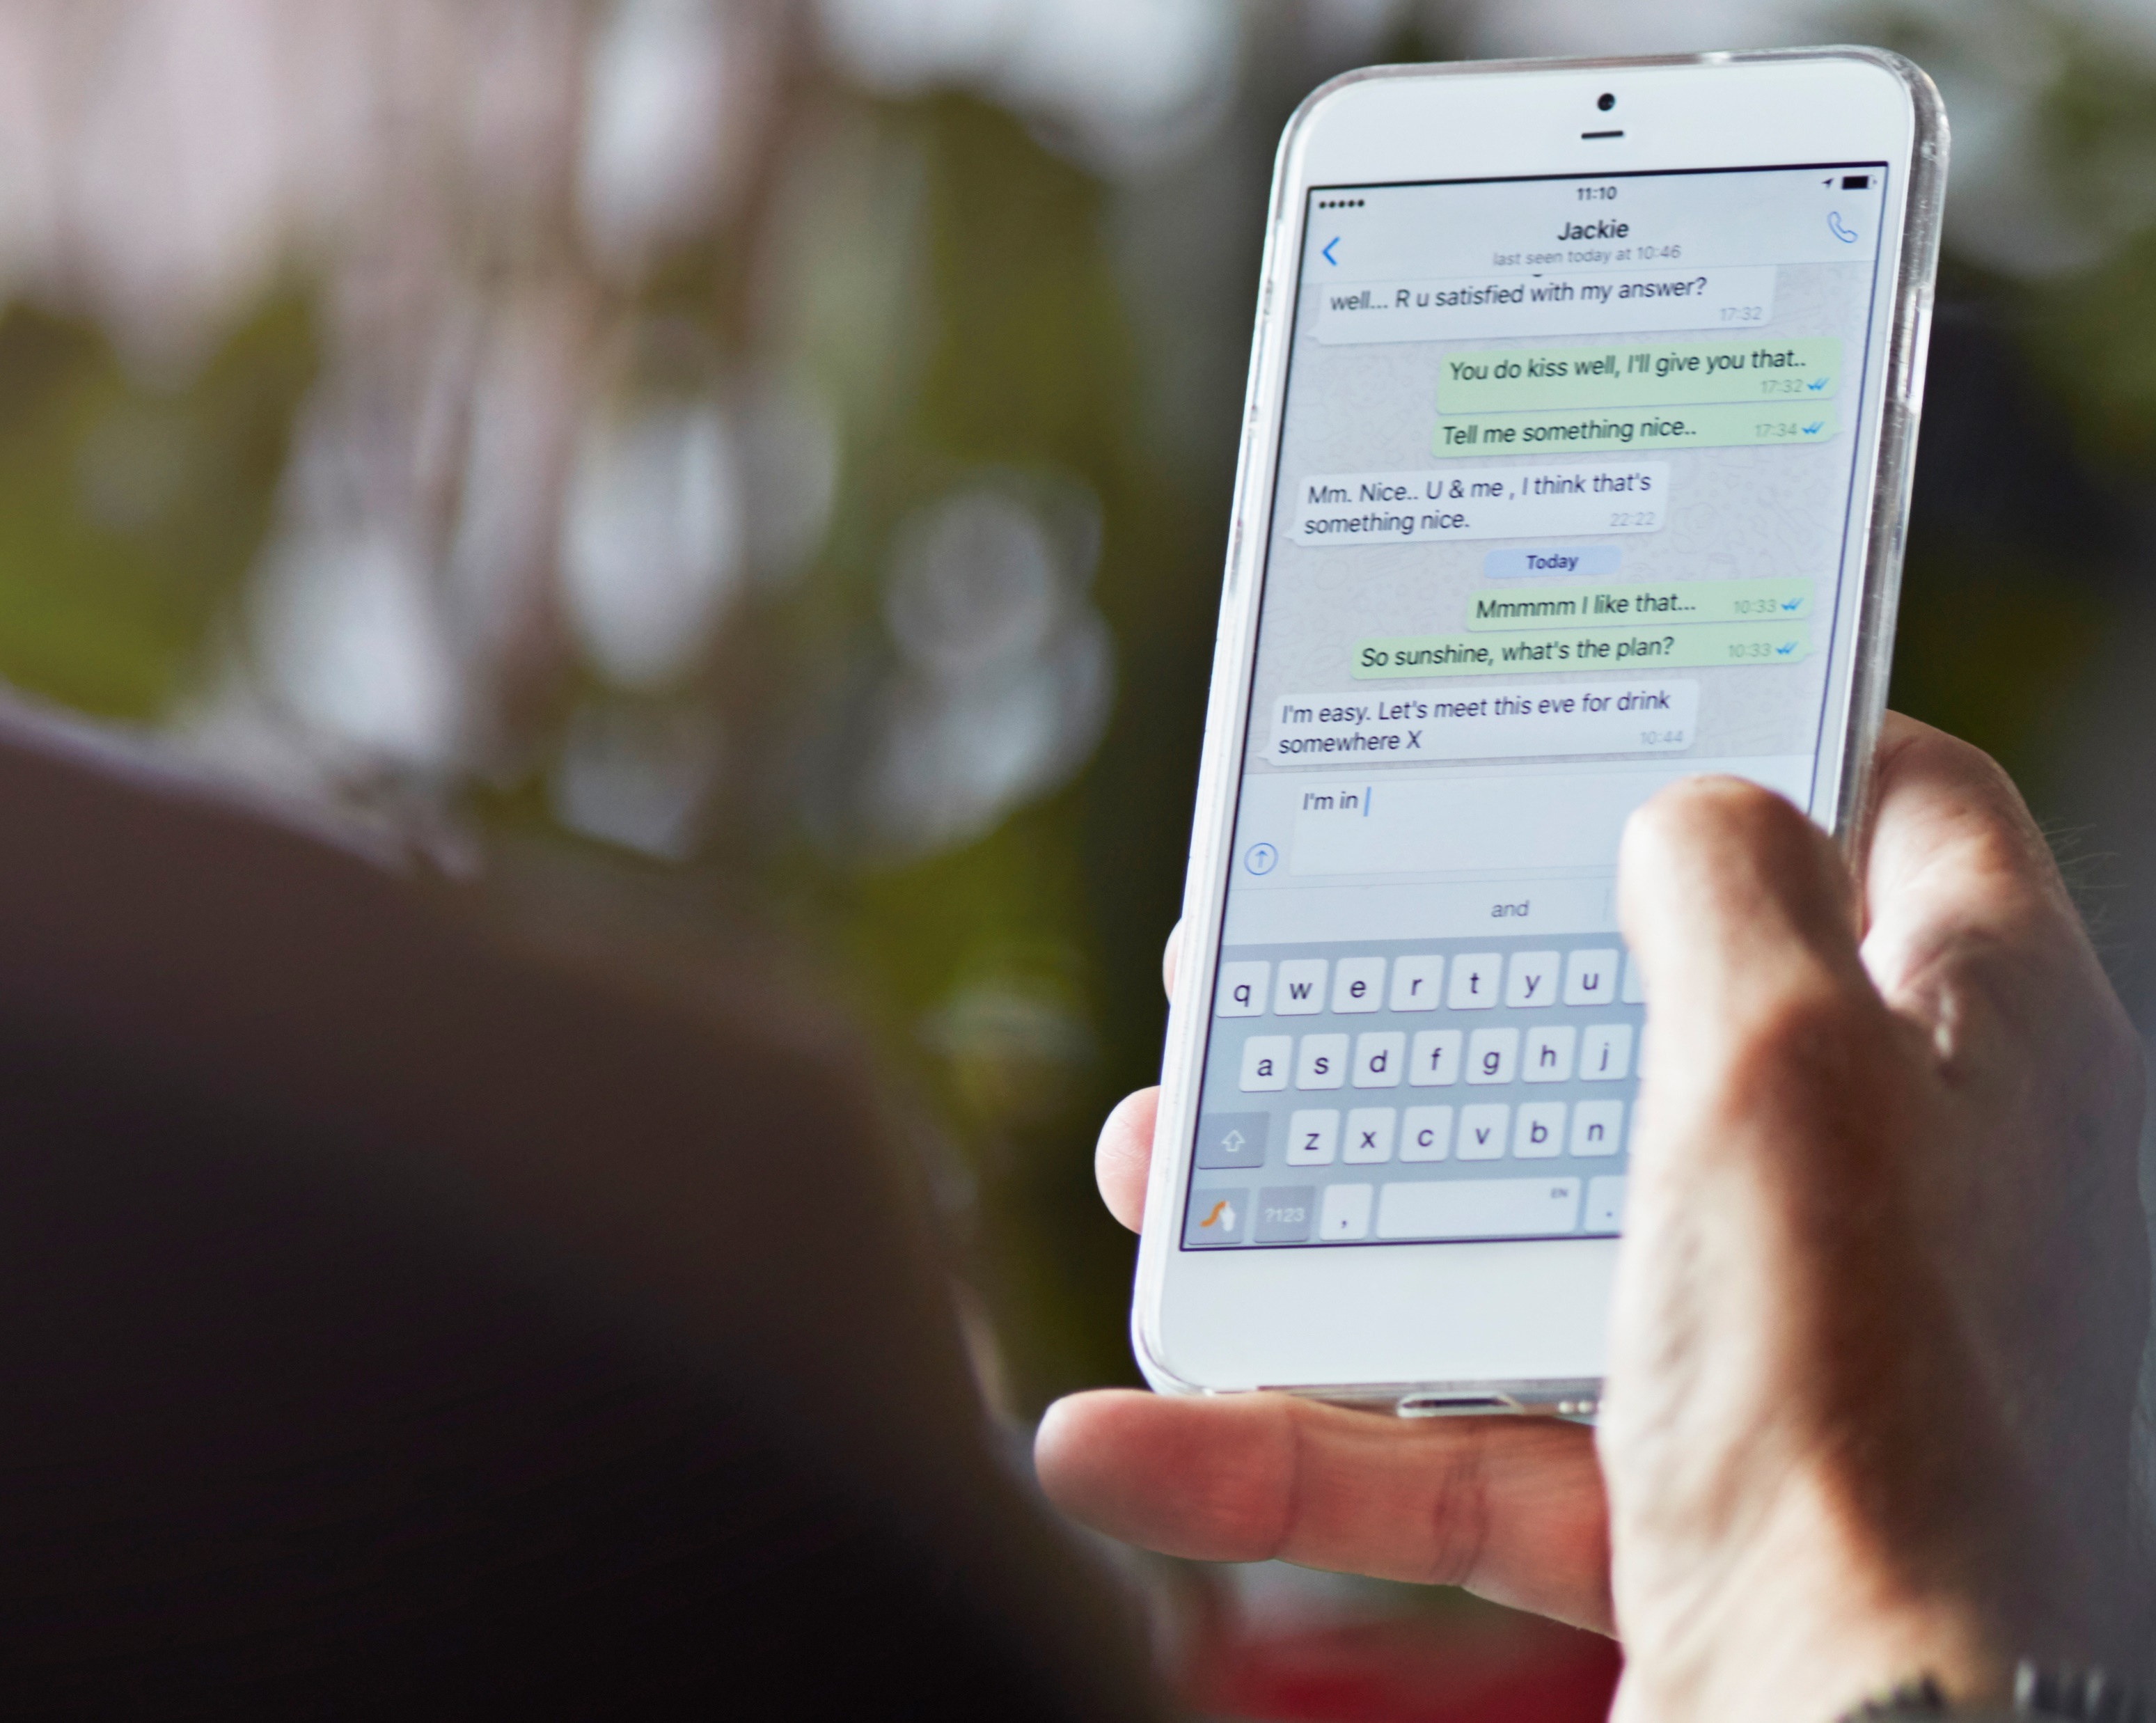
SMS Spam Classifier
Prachal, Ian, Umar, Hamza

